Slide 1


A Simple Guide to Matrices
Key Concepts from Linear Algebra

Slide 2
Contents
»
Why Study Linear Algebra?
»
What is Linear Algebra?
»
Definitions: Matrix, Vector, Scalar
»
Matrix Algebra & Transpose
»
Matrix Multiplication
»
Special Types of Matrices
»
Linear Systems (Ax = b)
»
The Three Solution Types
»
Elementary Row Operations (EROs)
»
Row Echelon Form (REF)
»
Reduced Row Echelon Form (RREF)
»
Gaussian vs. Gauss-Jordan
»
Rank of a Matrix
»
Rank & System Solutions
»
Pivot vs. Free Variables
»
Minor, Cofactor, Determinant
»
Adjoint & Inverse (Method 1)
»
Finding the Inverse (Method 2)
»
Practice Questions

Slide 3






Why Study Linear Algebra?
Data Representation
Distance & Similarity
Data Redundancy
Represents complex data as simple vectors. A house can be a vector: [Bedrooms, Area, Price]. Text (like from AI models) is also converted to vectors.
The "dot product" (a vector operation) is used to measure the distance or similarity between two pieces of data, like two documents or images.
We can check if two vectors are "linearly dependent." If they are, one vector is just a combination of the other and might be redundant data.

Slide 4





Definitions: The Building Blocks
Matrix
Vector
Scalar
A rectangular grid (or array) of numbers arranged in rows and columns.
A simple matrix that has only one row (a row vector) or only one column (a column vector).
Just a single, plain number (like 5, -3, or 0.5), not a grid.

Slide 5


Basic Operations
Matrix Algebra
Transpose A^{T}
•
Addition (A+B): Add the numbers in the matching positions. (Matrices must be the same size).
•
The Rule: Flip the matrix over its diagonal.
•
The 1st row becomes the 1st column, the 2nd row becomes the 2nd column, and so on.
•
Scalar Multiply (cA): Multiply *every* single number inside the matrix by the scalar (c).
•
Important Rule: AB^{T} = B^{T} A^{T}

Slide 6
Matrix Multiplication (C = AB)
The Rule: The number of *columns* in the 1st matrix (A) must equal the number of *rows* in the 2nd matrix (B).
The Result: If A is (m x n) and B is (n x p), the result C will be (m x p).
How-To: Multiply each element of a *row* from A by the matching element of a *column* from B, then add the results.
Warning: Order matters! In most cases, AB is NOT the same as BA.

Slide 7
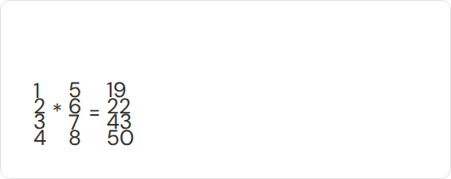
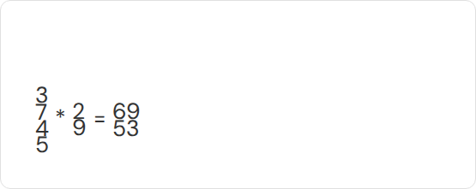
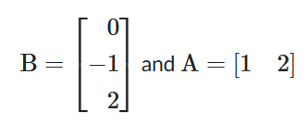
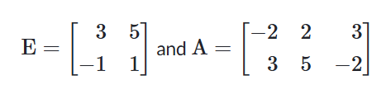
Sample Questions: Multiplication
Question 1
Question 2

Slide 8
Special Types of Matrices
Symmetric: A matrix that is equal to its own transpose. A = A^{T}
Skew-Symmetric: A matrix that is the *negative* of its transpose. A = - A^{T}
Triangular: Has all zeros either *above* (Lower) or *below* (Upper) the main diagonal.
Diagonal: Has all zeros *except* on the main diagonal.
Identity (I): A diagonal matrix with only 1s on the diagonal. It's the matrix version of the number 1.

Slide 9
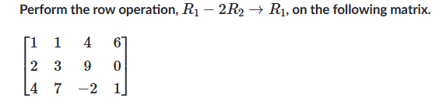
Elementary Row Operations (EROs)
These are the three "legal moves" you can use to simplify a matrix and solve linear systems.
1. SWAP: Interchange any two rows.
2. SCALE: Multiply one entire row by any non-zero number.
3. ADD: Add a multiple of one row to another row. (This is the workhorse!)

Slide 10
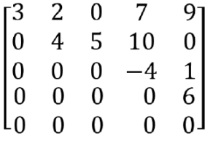
Row Echelon Form (REF)
A "staircase" shape achieved using EROs. It follows these rules:
Rule 1: All-zero rows (if any) are at the very bottom.
Rule 2: The first non-zero number in any row (called a "pivot") is to the right of the pivot in the row above it.
Rule 3: All entries in a column below a pivot must be zeros.

Slide 11
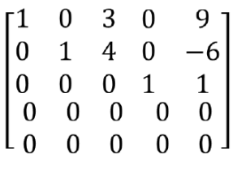
Reduced Row Echelon Form (RREF)
A "stricter" and fully simplified version of REF. It adds two more rules:
In addition to REF :
Rule 1: Every pivot (leading entry) must be a 1.
Rule 2: The pivot is the only non-zero entry in its entire column (all numbers *above* and *below* it are zero).

Slide 12
Rank of a Matrix
What is Rank?
The rank is simply the number of non-zero rows after you have put the matrix into REF or RREF.
Rank
(It is also the number of "pivot" columns).
The rank is a fundamental property of a matrix and tells you everything about the solution to a linear system.

Slide 13
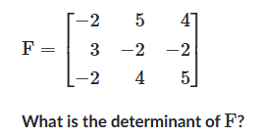






Minor, Cofactor, Determinant
Minor
Cofactor
Determinant
The determinant of the small matrix that's left after you delete one row and one column.
The "signed" minor. You multiply the minor by +1 or -1 based on a "checkerboard" pattern (+, -, +, ...).
A single number (det(A)) that describes the matrix. Found by summing the products of elements in one row by their cofactors.

Slide 14
Determinant of a Matrix
Like finding avg of the numbers in matrix
Only defined for square matrix ( no. of rows = no. of cols)
Steps to find determinants:
• Find minors for 1st row element
• Find cofactor for them
• Add them together to get determinant

Slide 15
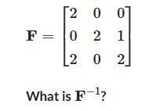

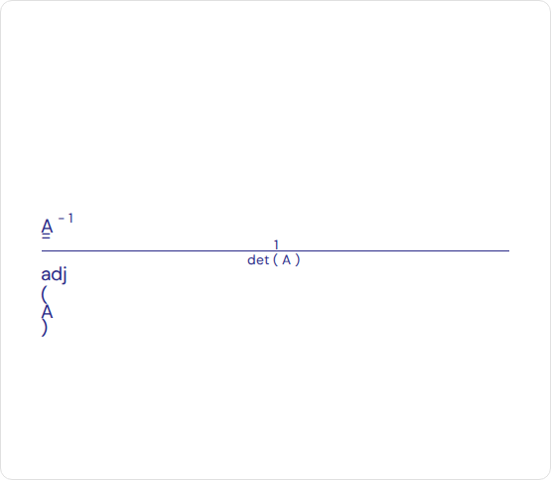

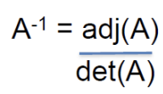
Adjoint & Inverse
Adjoint: adj(A)
Inverse: A ⁻ ¹
The matrix that "undoes" A.
A A ⁻ ¹ = I (identity matrix)
The adjoint is a "helper" matrix used to find the inverse.
Formula:
•
1. Create a new matrix filled with all the cofactors (C).
•
2. Take the transpose of that cofactor matrix.
•
adj(A) = C ^{T}
IMPORTANT: If det(A) = 0, the inverse does not exist!

Slide 16
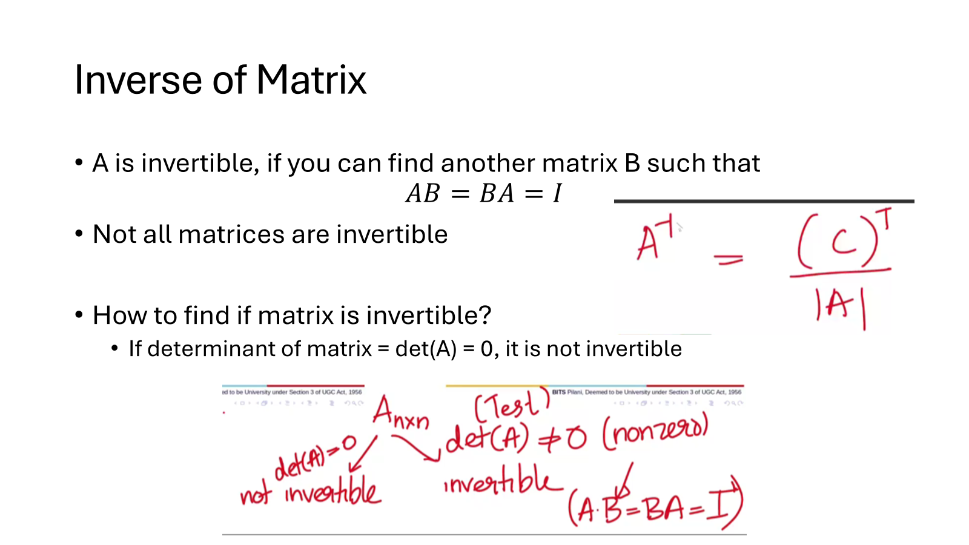
Adjoint & Inverse
Adjoint: adj(A)
Inverse: A ⁻ ¹
The matrix that "undoes" A.
A A ⁻ ¹ = I (identity matrix)
The adjoint is a "helper" matrix used to find the inverse.
Formula:
•
1. Create a new matrix filled with all the cofactors (C).
•
2. Take the transpose of that cofactor matrix.
•
adj(A) = C ^{T}
IMPORTANT: If det(A) = 0, the inverse does not exist!

Slide 17


Gaussian vs. Gauss-Jordan Elimination
Gaussian Elimination
Gauss-Jordan Elimination
The process of using EROs to get a matrix into Row Echelon Form (REF).
The process of using EROs to get a matrix all the way to Reduced Row Echelon Form (RREF).
This leaves you with a "staircase" matrix. You then solve the system from the bottom up (this is called "back substitution").
This is more work, but the final answer can be read directly from the matrix. No substitution is needed.
Goal: Get an Upper Triangular matrix.
Goal: Get the Identity Matrix (or as close as possible).

Slide 18


Linear Systems (Ax = b)
The Setup
The Augmented Matrix
A "system of linear equations" is the core problem of linear algebra. We use matrices to solve it.
To solve, we combine A and b into one "augmented matrix".
[ A | b ]
•
Matrix Form: We write the system as Ax = b.
We then perform row operations on this single matrix to find the solution for x.
•
A: The coefficient matrix (all the numbers next to the variables).
If b = 0 (all zeros), it's a Homogeneous system.
•
x: The vector of unknown variables.
•
b: The vector of results (the numbers after the = sign).

Slide 19
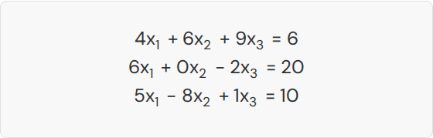
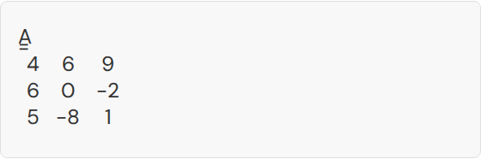
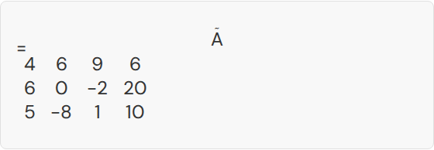
Application: Representing Linear Systems
System of Equations
Coefficient Matrix (A)
Contains only the coefficients of the unknowns.
Augmented Matrix ( A ˜ )
Includes the coefficients and the right-hand side.

Slide 20
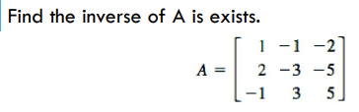
Finding the Inverse (Method 2: Gauss-Jordan)
This is a more practical method for large matrices. It uses EROs.
Step 1: Create a new "augmented" matrix by placing the Identity matrix (I) next to A.
[ A | I ]
Step 2: Use Gauss-Jordan Elimination (EROs) to turn the left half (A) into the Identity Matrix.
Step 3: What's left on the right half is your answer!
[ I | A-1 ]
If you can't get I on the left (e.g., you get a row of zeros), the matrix has no inverse.

Slide 21



Pivot vs. Free Variables
Pivot Variables
Free Variables
These are the variables that correspond to a pivot column in the RREF matrix.
These are the variables that correspond to a non-pivot column = col without a pivot
A pivot column is any column that contains a leading '1'.
A non-pivot column has no leading '1' in it.
You can set these variables to any value (like 't' or 's'), which is why you get an infinite number of solutions.
The values of these variables are dependent on the other variables.

Slide 22
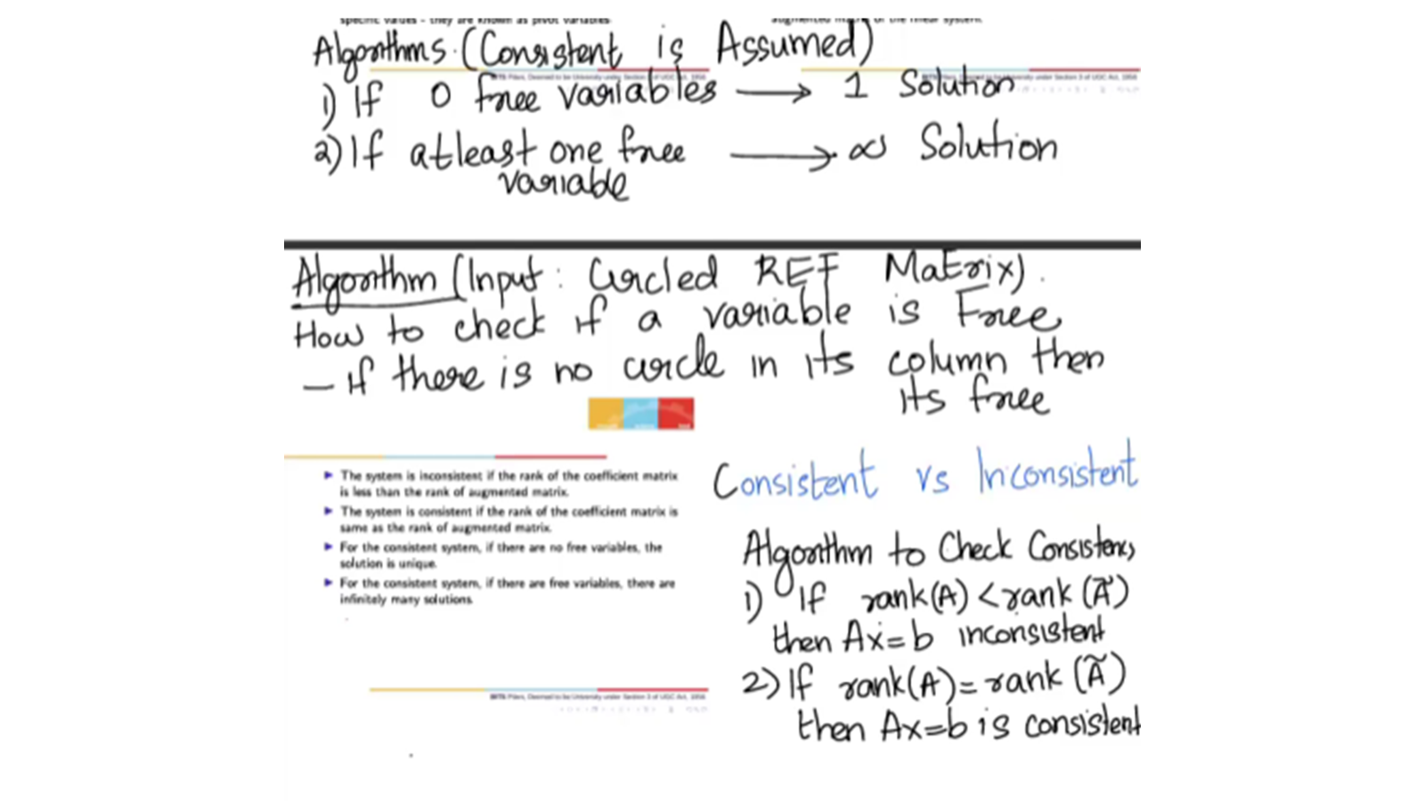

Slide 23
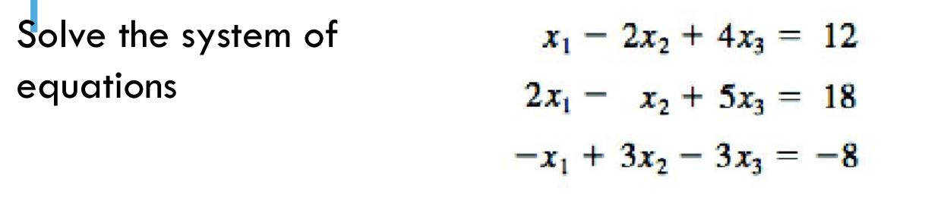
Linear Systems (Solving Ax = b)
This is why we do all this! Use EROs on the Augmented Matrix A | b to find the solution.
One Unique Solution: Ranks are equal and match the number of variables.
There are no free variables
Rank(A) = Rank([A | b]) = n
Consistent Soln:
Consistent Soln:
Infinite Solutions: Ranks are equal, but less than the number of variables.
This means you have free variables
Rank(A) = Rank([A | b]) < n
No Solution: Ranks are unequal
Rank(A) < Rank([A | b])
Inconsistent Soln:

Slide 24
Linear Systems (Solving Ax = b)
Step 1: ⭕
Pivot = 1st non-zero number in a row = circled
Step 2: col with ⭕
Pivot variable = a column having a pivot number (circle)
Free variable = a column not having a pivot number (circle)
Step 3: Consistent solution
♾️ soln = atleast 1 free variable
1️⃣ soln = no free variable

Slide 25
Algorithm to check consistency
rank(A) < rank(A:B) -> Inconsistent
(parallel lines/no possible answer)
rank(A) = rank(Ã) -> Consistent
Free Variables = 0 -> 1️⃣ soln
Free Variables >= 1 -> ♾️ soln

Slide 26
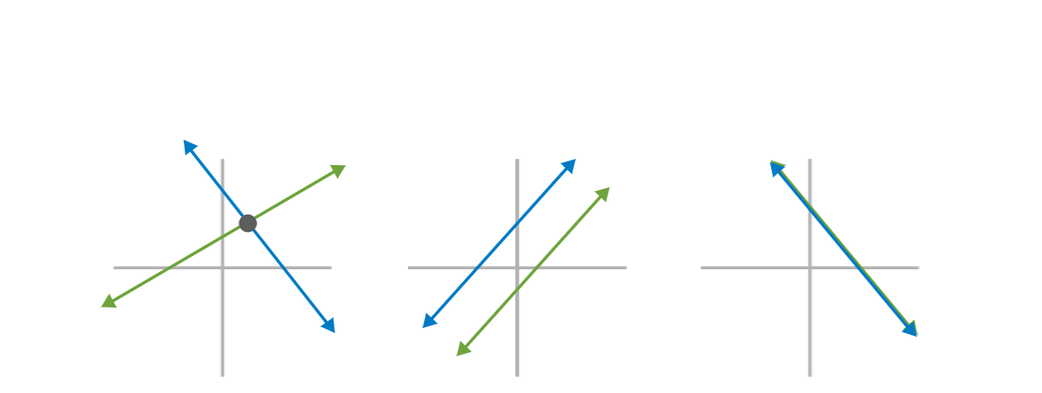
The Three Solution Types (Geometric View)
1. Unique Solution
2. No Solution
3. Infinitely Many Solutions
The lines intersect at exactly one point.
(Consistent)
The lines are parallel and never touch.
(Inconsistent)
Both equations describe the same line.
(Consistent)

